Slide 1
One Factor Experiment
Chapter 13

Slide 2
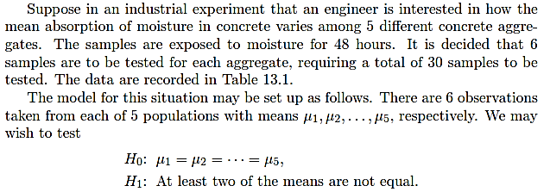

Slide 3
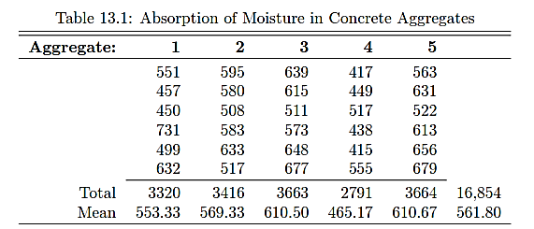

Slide 4
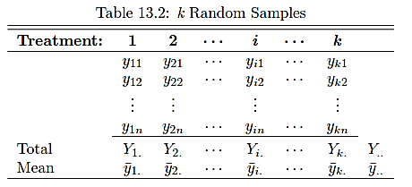

Slide 5
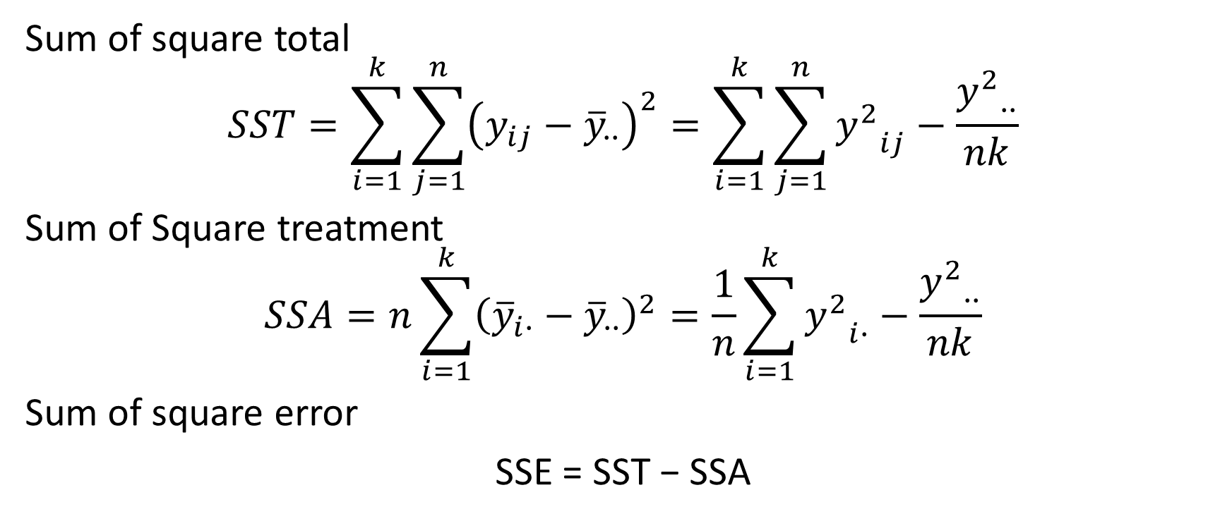
Important Measures of Variability
Sum of square total
$$SST=\sum_{i=1}^{k}{\sum_{j=1}^{n}{{\left(y_{ij}−{\overline{y}}_{∙∙}\right)}^{2}}}=\sum_{i=1}^{k}{\sum_{j=1}^{n}{{y^{2}}_{ij}−\frac{{y^{2}}_{∙∙}}{nk}}}$$
Sum of Square treatment
$$SSA=n\sum_{i=1}^{k}{{\left({\overline{y}}_{i∙}−{\overline{y}}_{∙∙}\right)}^{2}}=\frac{1}{n}\sum_{i=1}^{k}{{y^{2}}_{i∙}−\frac{{y^{2}}_{∙∙}}{nk}}$$
Sum of square error
SSE = SST − SSA

Slide 6
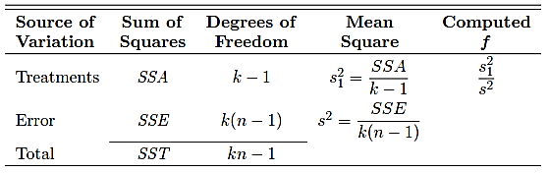
Analysis of Variance ANOVA

Slide 8
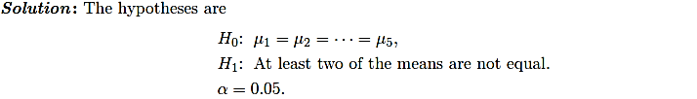
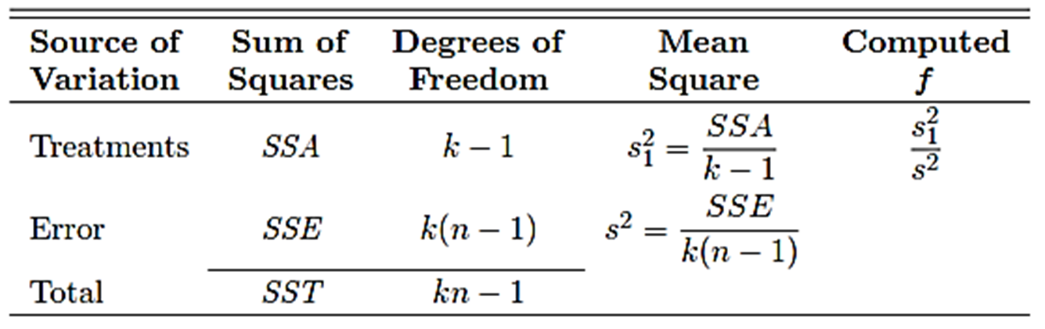

Slide 9
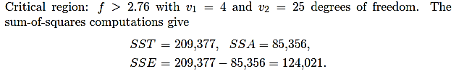

Slide 10
Ex 13.3 - 13.5

